Slide 1

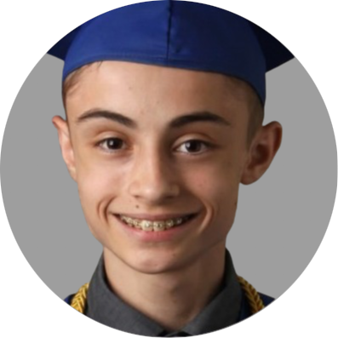


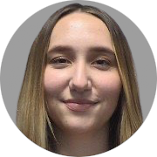



Diverse Makers
Daniel
Minichetti
Lead
Kane Davidson
Architect
Eduardo
De La Rosa
QA
Elleana
Negrelli
Recorder
Aaron
Ramirez
Communicator
CS Faculty
Capstone Mentor
Isaac Shaffer
Vahid Nikoonejad Fard
Notes:
Move everything up

Slide 2

About our Client
Experience in the Field
Uses research through design to develop therapy games and playful applications that help improve and maintain health
Research Focus
Specializes in serious games for health that emphasize human-computer interaction with assistive technology
Dr. Jared Duval
Assistant Professor - SICCS NAU
Director of Playful Health Technology Lab

Slide 3

Lack of STEM Accessibility
Current STEM Landscape
“Over 40 million Americans have a disability, however, research shows that disabled people are severely underrepresented in STEM fields. So much so that only 3% of people in the STEM workforce have a disability.”
Potential Solution
STEM learning opportunities are not equally accessible to those with disabilities
Makerspaces offer hands-on STEM learning outside school

Slide 4


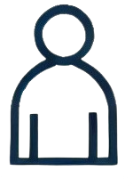
Issues in STEM Accessibility
Limited Physical Access to Makerspaces
Many makerspaces are not physically accessible to individuals with disabilities
Lack of Accessible Learning Resources
Current STEM materials and maker project guides do not cater to diverse learning needs
Social Isolation in STEM Fields
Those with disabilities face social barriers leading to a lack of community

Slide 5
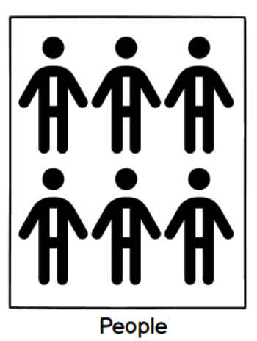
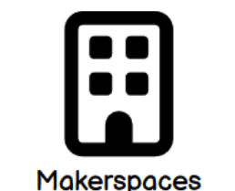
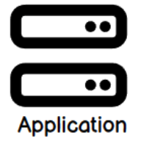
Making STEM More Accessible
Crowdsourced mobile application serves as a central hub for sharing STEM resources
Provides STEM resource hosting and sharing for makerspaces
Accessible interface and STEM content supporting multiple disabilities
Allows users to discover and connect with local makerspaces with custom profiles
Uploads STEM Resources
Views STEM Resources

Slide 6



Requirements and Specifications
Functional Requirements
Secure user authentication
Resource hosting for STEM content
Accessible UI for multiple disabilities
Location-based makerspace discovery
Search and filter system
Performance Requirements
Cross-platform compatibility
Responsive layout and design
Optimized data retrieval for STEM content
Real-time updates and synchronization

Slide 7


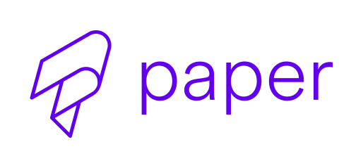

Architecture and Implementation
System Architecture Components
User Interface
Buttons, navigation, and accessibility options
Business Logic
Data validation, organization, and rules
Data Access
Data storage, modification, and retrieval
Implementation Details
Frontend: React Native
Cross-platform consistency
Accessible UI components with React Paper
Material Design principles
Backend: Google Firebase
User authentication services
Real-time database for hosting
Search and filter functionality

Slide 8
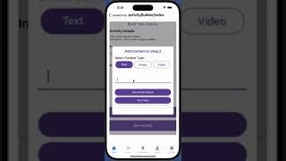
Prototype Demonstration
Scenario 1: Visual Impairment User
Account creation and login
High contrast mode
Font size adjustment
Scenario 2: Content Creation
STEM Resource creation and upload
Scenario 3: Community Connection
Makerspace discovery
Profile interaction

Slide 9
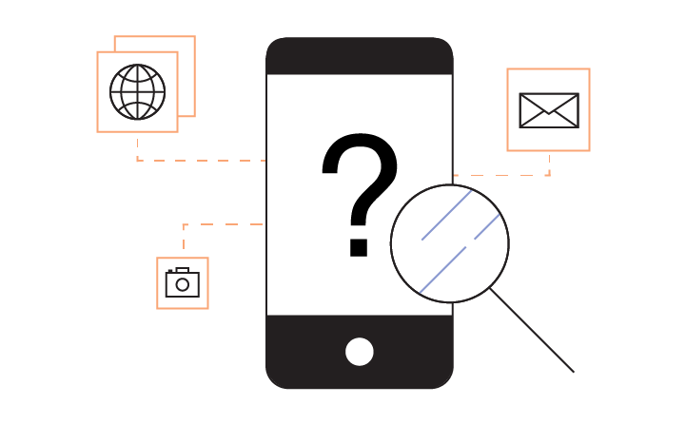

Challenges and Resolutions
Unintuitive system for Makerspaces
Problem: Poor design of application could lead to low usage and contribution
Resolution: Communication with client and stakeholders
Disability Negligence
Problem: Unintended negligence of certain disabilities when accommodating for others
Resolution: Follow proper design principles such as WCAG

Slide 10


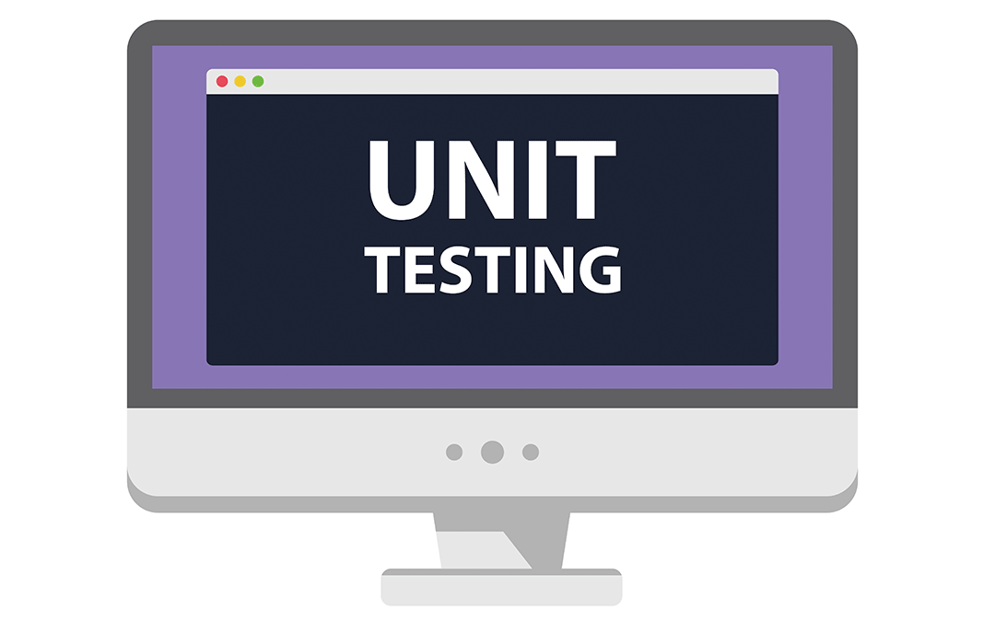

Testing Plan
Testing Distribution
Unit Testing (50%)
Core component functionalities
User authentication, content management, accessibility features
Integration Testing (25%)
Front-end and back-end communication
Usability Testing (25%)
End user validation
Key Metrics
Task completion rates
Error rates
User satisfaction scores
Accessibility compliance

Slide 11
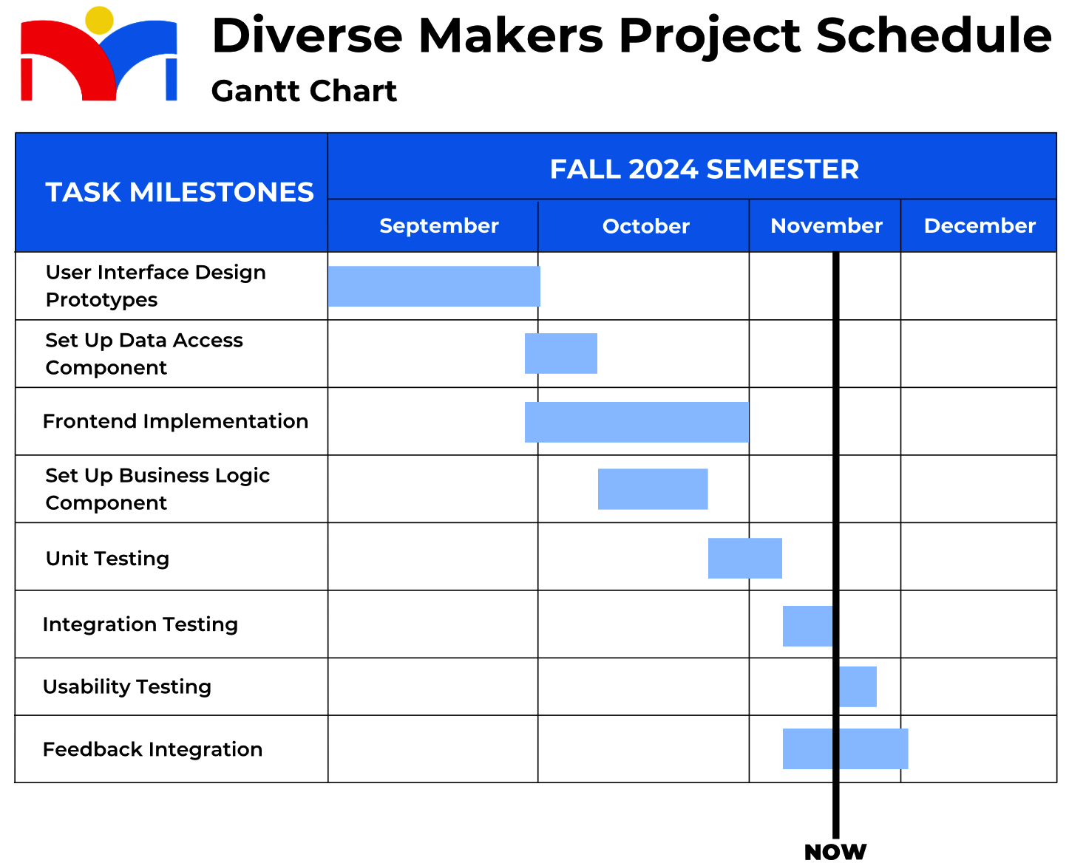

Slide 12


Conclusion
Project Importance
Solution
Implementation
Future Steps
Breaking barriers
in STEM learning opportunities
Mobile application enforces usability and accessibility
React Native, Google Firebase, and Google Firestore
Testing plan implementation
User feedback integration and validation
Deployment

Slide 13
Thank you!
Any Questions?

